Slide 1
Big data analytics and visualization
Lino Tadros
Jason Horner
Notes:
Information in this document, including URL and other Internet Web site references, is subject to change without notice. Unless otherwise noted, the example companies, organizations, products, domain names, e-mail addresses, logos, people, places, and events depicted herein are fictitious, and no association with any real company, organization, product, domain name, e-mail address, logo, person, place or event is intended or should be inferred. Complying with all applicable copyright laws is the responsibility of the user. Without limiting the rights under copyright, no part of this document may be reproduced, stored in or introduced into a retrieval system, or transmitted in any form or by any means (electronic, mechanical, photocopying, recording, or otherwise), or for any purpose, without the express written permission of Microsoft Corporation.
Microsoft may have patents, patent applications, trademarks, copyrights, or other intellectual property rights covering subject matter in this document. Except as expressly provided in any written license agreement from Microsoft, the furnishing of this document does not give you any license to these patents, trademarks, copyrights, or other intellectual property.
The names of manufacturers, products, or URLs are provided for informational purposes only and Microsoft makes no representations and warranties, either expressed, implied, or statutory, regarding these manufacturers or the use of the products with any Microsoft technologies. The inclusion of a manufacturer or product does not imply endorsement of Microsoft of the manufacturer or product. Links may be provided to third party sites. Such sites are not under the control of Microsoft and Microsoft is not responsible for the contents of any linked site or any link contained in a linked site, or any changes or updates to such sites. Microsoft is not responsible for webcasting or any other form of transmission received from any linked site. Microsoft is providing these links to you only as a convenience, and the inclusion of any link does not imply endorsement of Microsoft of the site or the products contained therein.
© 2021 Microsoft Corporation. All rights reserved.
Microsoft and the trademarks listed at https://www.microsoft.com/en-us/legal/intellectualproperty/Trademarks/Usage/General.aspx are trademarks of the Microsoft group of companies. All other trademarks are property of their respective owners.

Slide 2
Abstract and learning objectives
Abstract
Deploy a web app using Machine Learning (ML) to predict travel delays given flight delay data and weather conditions. Plan a bulk data import operation, followed by preparation, such as cleaning and manipulating the data for testing and training your Machine Learning model.
Learning objectives
Build a complete Machine Learning (ML) model hosted on Databricks
Integrate an Azure Databricks web service into a Web App
Use Azure Data Factory (ADF) for data movement and operationalizing ML scoring
Summarize data with HDInsight and Spark SQL
Visualize batch predictions on a map using Power BI
Notes:
This is an introduction to the Cloud Workshop at a high level. Later we’ll get into customer objections, requirements, etc… but we want to ground the participants on the business outcomes we’re going after for the day.

Slide 3
Step 1: Review the customer case study
Outcome
Analyze your customer needs.
Timeframe
15 minutes

Slide 4

Customer situation
Margie's Travel (MT) provides concierge services for business travelers.
They are interested in using predictive analytics to differentiate themselves in an increasingly crowded market.
Notes:
Margie's Travel provides concierge services for business travelers
Working In an increasingly crowded market
Always looking for ways to differentiate themselves and provide added value to their corporate customers.
Looking to capitalize on their existing data assets to provide new insights that provide them a strategic advantage against their competition
Interested in using predictive analytics to help customers best select their travels.

Slide 5

Customer situation - 2
Proposed solution to provide flight delay risk assessment to customers
Plan to use 30 years of flight delay and weather data
Want to pilot the solution internally
Notes:
Most premium customers often book their travel within seven days of departure and often ask questions like, “I don’t have to be there until Tuesday, so is it better for me to fly out on Sunday or Monday?”
MT believes an innovative solution is to provide customers an assessment of the risk of encountering flight delays based on historical trends in weather patterns.
Flight delay predictions would be presented to customers through a web-based map visualization.
MT has over 30 years of historical flight data provided to them by the United States Department of Transportation (USDOT), and the historical weather condition for each flight as CSV files. They plan to use this data to predict the likelihood of flight delays to help customers plan their trips.
REST API calls to a 3rd party service will be used to retrieve current weather forecasts.
MT plans to pilot this solution internally, whereby the small population of customer support who service MT’s premium tier of business travelers would begin using the solution and offering it as an additional data point for travel optimization.

Slide 6

Customer needs
Modernize their analytics platform
Ability to query data using SQL
Load and store all data in Azure
Use current weather forecast for flight delay predictions
Proof of concept (PoC) machine learning model
Web-based visualizations of flight delay predictions
Notes:
MT wants to modernize its analytics platform without sacrificing its ability to query data using SQL.
They are looking for an approach that allows them to store all of their data in Azure, including the unmodified source data and the cleansed data from which they query for production purposes.
MT wants to understand how they will load their large quantity of historical data into Azure. The data is currently stored on-premises.
They need the ability to query the current weather forecast and use it as input to their flight delay predictions.
They desire a proof of concept machine learning model that takes as input their historical data on flight delays and weather conditions to identify whether a flight is likely to be delayed or not.
Need web-based visualizations of the flight delay predictions.

Slide 7


Customer objections
How long does it take to create and operationalize a machine learning model?
Can we retrain and redeploy our models without breaking clients?

Slide 8

Customer objections - 2
What are the options for running SQL on Hadoop solutions in Azure?
Does Azure offer anything to speed up querying files in HDFS?
Can our users sign in with Azure AD, and can we require two-factor authentication, restrict access based on user, sign-in location, time of day, and detected suspicious activity?

Slide 9

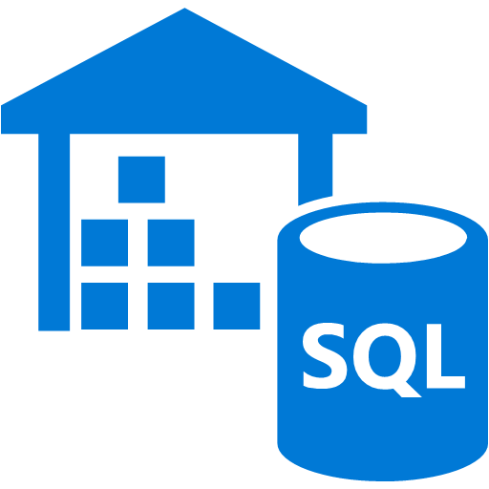


Customer objections - 3
Is Azure Data Lake a good fit for our PoC?
What data visualization tools are available on Azure? Can access to these be managed with Active Directory?
Is Azure Databricks our only option for running SQL on Hadoop solutions in Azure?
We are hiring a data scientist who prefers MLflow for model training and metrics. Can you support this?
Notes:
We have heard of Azure Data Lake, but we are not clear about whether this is currently a good fit for our PoC solution or whether we should be using it for interactive analysis of our data.
We would like to limit our SQL DW access using centralized Azure Active Directory accounts and groups. Is this possible? I thought I was limited to a user name and password.
Does Azure provide any tools for visualizing our data? Ideally, access to these could be managed with Active Directory.
We are hiring a data scientist who prefers to use MLflow to track model training run metrics and artifacts. Can the proposed Azure-based solution support this library?

Slide 10
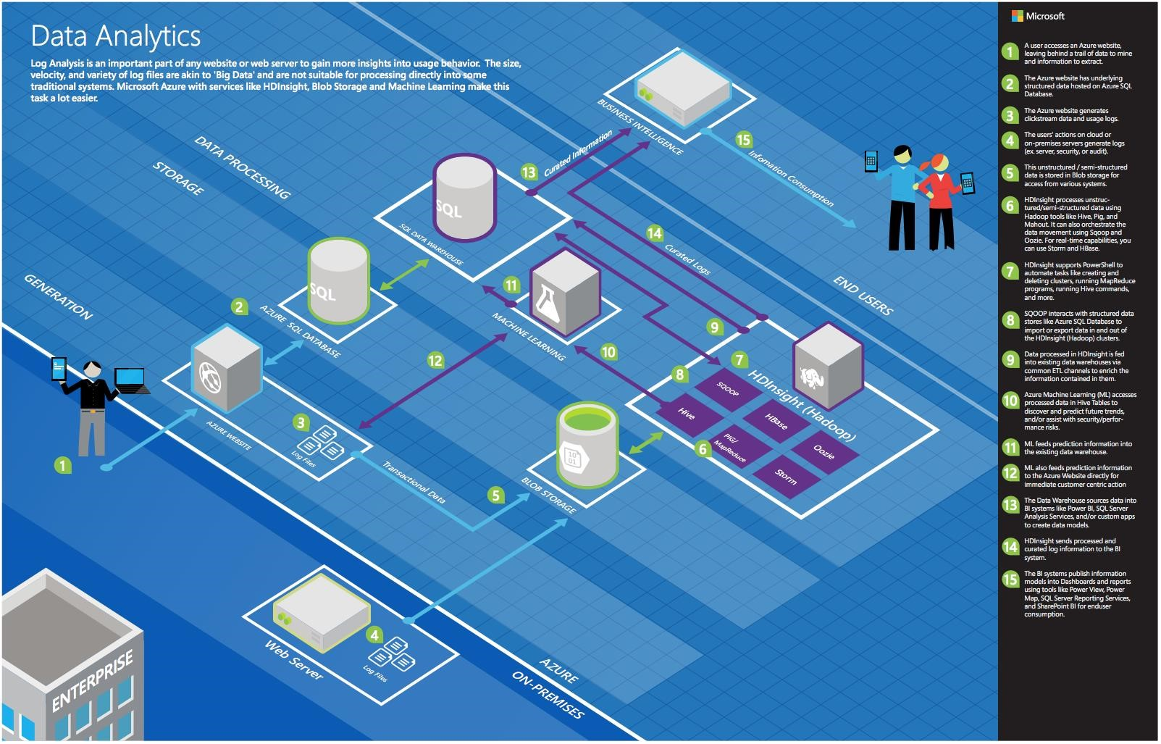
Common scenarios
Notes:
This is a diagram of a typical architecture for this type of scenario, from which you can draw inspiration from. You will find this diagram within the Whiteboard Design Session Student Guide.

Slide 11
Step 2: Design the solution
Outcome
Design a solution and prepare to present the solution to the target customer audience in a 15-minute chalk-talk format.
Timeframe
60 minutes
Business needs (15 minutes) | Respond to questions outlined in your guide and be prepared to present your solutions to others.
Design (35 minutes) | Design a solution for as many of the stated requirements as time allows.
Prepare (15 minutes) | Identify any customer needs that are not addressed with the proposed solution. Identify the benefits of your solution. Determine how you will respond to the customer’s objections. Prepare for a 15-minute presentation to the customer.

Slide 12
Step 3: Present the solution
Outcome
Present a solution to the target customer in a 15-minute chalk-talk format.
Timeframe
30 minutes (15 minutes for each team to present and receive feedback)
Directions
Pair with another team.
One group is the Microsoft team, the other is the customer.
The Microsoft team presents their proposed solution to the customer.
The customer asks one of the objections from the list of objections in the case study.
The Microsoft team responds to the objection.
The customer team gives feedback to the Microsoft team.
Switch roles and repeat Steps 2-6.

Slide 13
Wrap-up
Outcome
Identify the preferred solution for the case study.
Identify solutions designed by other teams.
Timeframe
15 minutes

Slide 14

Preferred target audience
Jack Tradewinds, CIO of Margie's Travel
The primary audience is business decision-makers and technology decision-makers
Usually, we talk to the Infrastructure Managers who report to the CIOs, to application sponsors (like a VP LOB, CMO), or to those who represent the Business Unit IT or developers that report to application sponsors
Notes:
Jack Tradewinds, CIO of Margie's Travel
The primary audience is business decision-makers and technology, decision makers.
Usually, we talk to the Infrastructure Managers who report to the CIOs or application sponsors (like a VP LOB, CMO) or to those that represent the Business Unit IT or developers that report to application sponsors.

